Slide 1


Jesus R Rosila Mares
12 October 2022

Slide 2
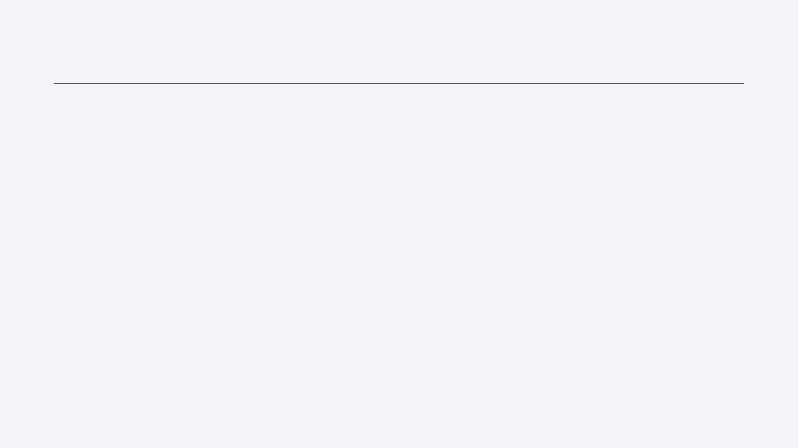
Outline
Executive Summary
Introduction
Methodology
Results
Conclusion
Appendix

Slide 3
Executive Summary
Summary of Methodologies
Web scraped using SpaceX API and python packages such as scikit-learn.
Cleaned and formatted data for data visualization and machine learning.
Split data into train and test.
Summary of all results
KSC launch site had highest success rate at 76.9% out of 13 launches.
Decision Tree method had highest accuracy at 88.9% with only 2 misclassifications
First Booster Stage landing on May 1, 2017

Slide 4
Introduction
Project background and context
Investigate SpaceX Falcon 9 First-stage Booster Recovery
Determine if flight will be a success or failure
Implement Machine Learning to Classify future launches successes
Problems you want to find answers
What type of Orbits and Payload Mass are being used? What is the success rate?
Where and when are they launching these missions?
How has years of experience increased SpaceX success
How well does trained models predict success

Slide 5

Section 1

Slide 6
Methodology
Executive Summary
Data collection methodology:
Data Scraping using SpaceX API
Perform data wrangling
Filtered and Used Regex to collected data from JSON
Perform exploratory data analysis (EDA) using visualization and SQL
Perform interactive visual analytics using Folium and Plotly Dash
Perform predictive analysis using classification models
Compare with: SVM, Tree, Log Reg, and KNN with GridSearchCV

Slide 7
Data Collection
SpaceX API Requests
Clean data
Down select to hone-in only to Falcon 9 launches
Fix null and missing values
Use in following data analysis

Slide 8
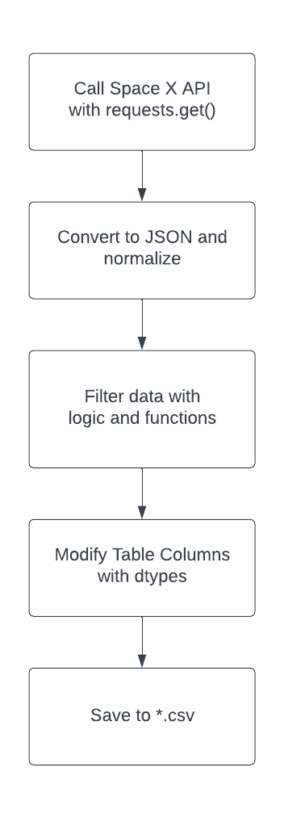
Data Collection – SpaceX API
Use SpaceX API to scrape data for Statistical Data Analysis and Machine Learning
Notebook @ Git

Slide 9
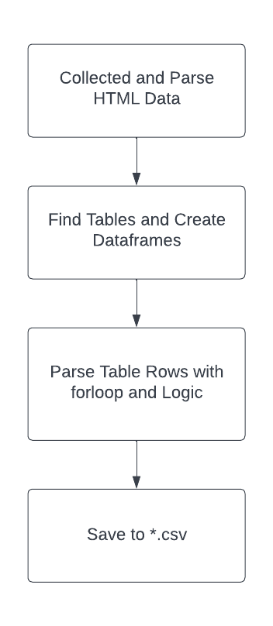
Data Collection - Scraping
Scrape data from generated CSV files
Apply filters to get desired output
Notebook @ Git
{'Flight No.': 121, 'Launch site': 121, 'Payload': 121,
'Payload mass': 121, 'Orbit': 121, 'Customer': 121,
'Launch outcome': 121, 'Version Booster': 121, 'Booster landing': 121, 'Date': 121,
'Time': 121}

Slide 10
Data Wrangling
Classify Success and Failures from scraped data
True ASDS, None None, True RTLS, False ASDS, True Ocean, False Ocean, None ASDS, False RTLS
Collect success and failures to ‘Class’ column
Prep for Data Analysis
Notebook @ Git

Slide 11
EDA with Data Visualization
Success Rates for each Orbit type
Payload Mass per each Orbit type
Payload Mass per Flight Number
Flights per Launch Site and Classified Success
Notebook @ Git

Slide 12
EDA with SQL
Query database for DISTINCT site launch locations
Find how many NASA missions there were
Average Payload Mass for F9 v1.1 Booster
First Ground Success
Sub-Query for Booster landing failures
Notebook @ Git

Slide 13
Build an Interactive Map with Folium
Mark all Falcon 9 Launch Sites
Use ‘Class’ Label to define success and failures
Find distances of Points of Interests to Launch Sites
Notebook @ Git

Slide 14
Build a Dashboard with Plotly Dash
Build Dash dashboard for manger use
Inputs: Launch Sites and Payload Mass slider
Populate with Success or Success Rate Pie Charts
Display Launch Site specific ‘Class’ within Payload Mass slider
Notebook @ Git

Slide 15
Predictive Analysis (Classification)
One Hot Encoding
Machine Learning Methods
SVM, Tree, Log Reg, and KNN with GridSearchCV
Compare with accuracies
Confusion Matrices
Notebook @ Git

Slide 16
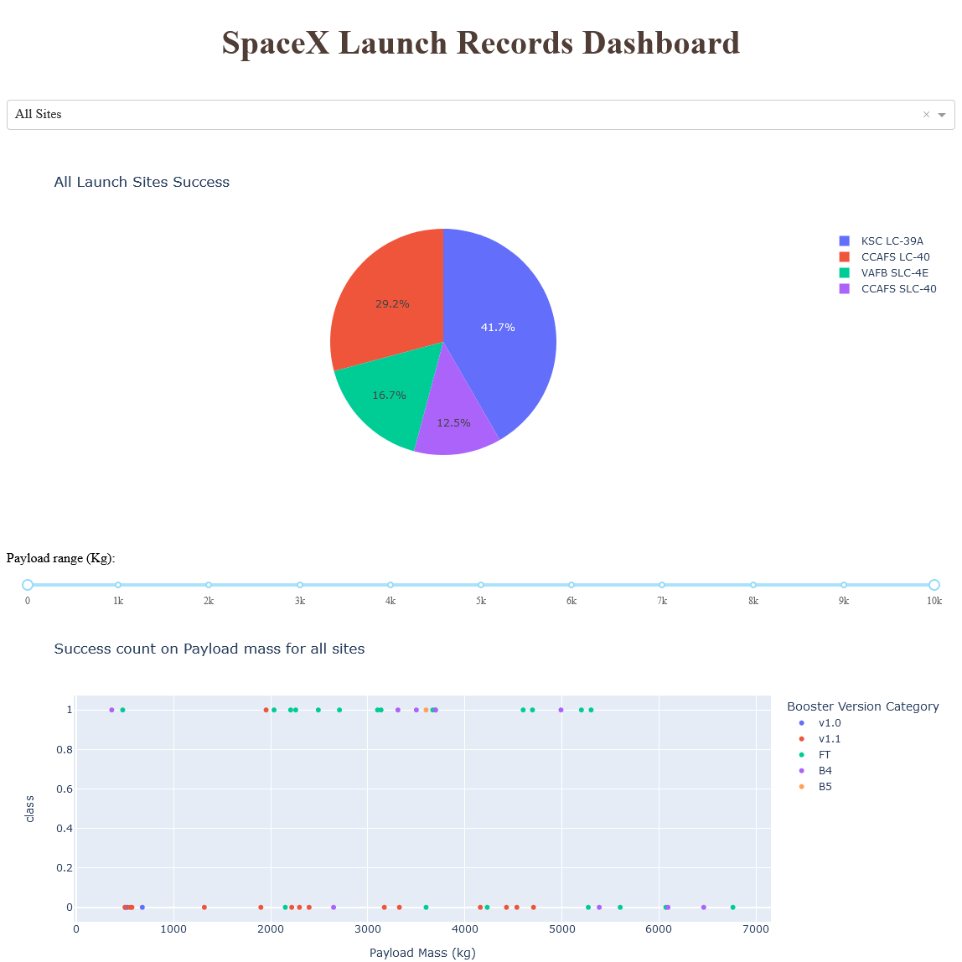
Results
 | Orbit | success | attempts | SuccessRate
0 | ES-L1 | 1 | 1 | 1.000000
1 | GEO | 1 | 1 | 1.000000
2 | GTO | 14 | 27 | 0.518519
3 | HEO | 1 | 1 | 1.000000
4 | ISS | 13 | 21 | 0.619048
5 | LEO | 5 | 7 | 0.714286
6 | MEO | 2 | 3 | 0.666667
7 | PO | 6 | 9 | 0.666667
8 | SO | 0 | 1 | 0.000000
9 | SSO | 5 | 5 | 1.000000

Slide 17

Section 2

Slide 18
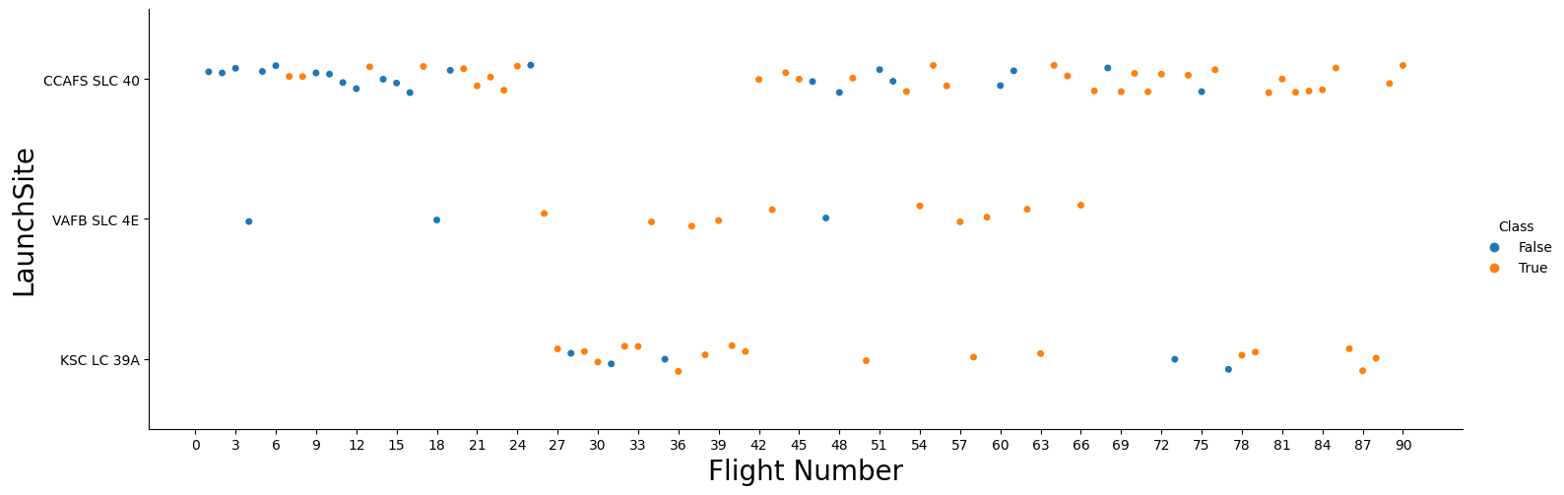
Launch Site vs. Flight Number

Slide 19
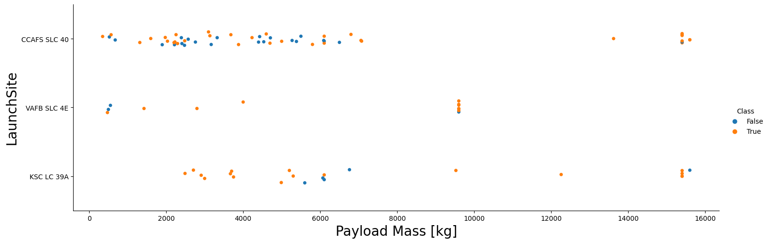
Launch Site vs. Payload

Slide 20
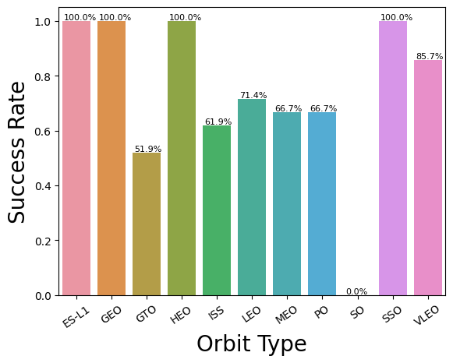
Success Rate vs. Orbit Type
Orbit Shorthand | Orbit Name
ES-L1 | Heliocentric Lagrange Point 1
GEO | Geocentric Orbit
HEO | Heliocentric Orbit
ISS | LEO to International Space Station
LEO | Low Earth Orbit
MEO | Medium Earth Orbit
PO | Polar Orbit
SO | Sub-Orbital
SSO | Sun-Synchronous Orbit
VELO | Very Low Earth Orbit

Slide 21
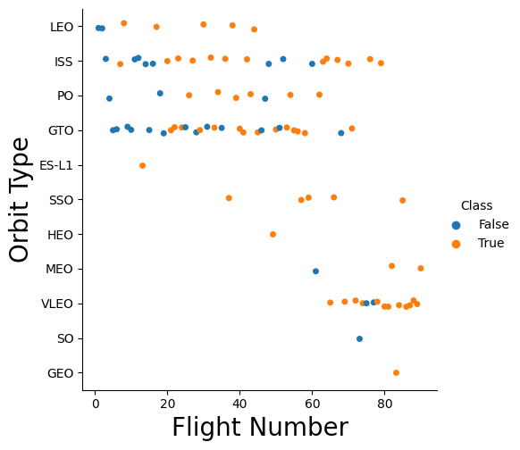
Orbit Type vs. Flight Number

Slide 22
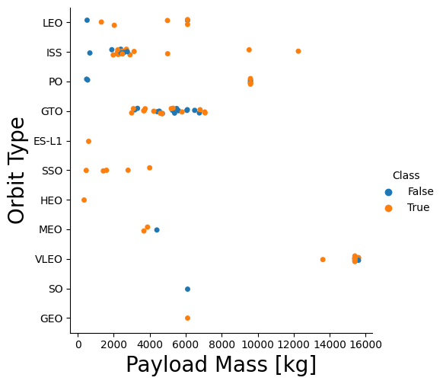
Orbit Type vs. Payload

Slide 23
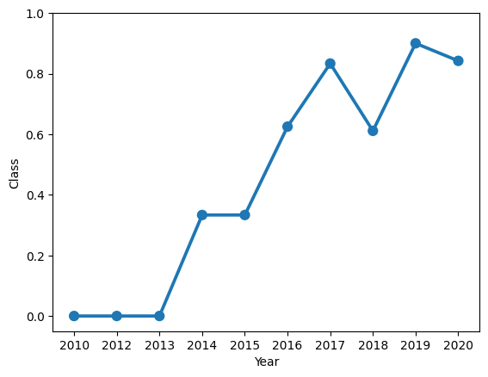
Launch Success Yearly Trend

Slide 24
All Launch Site Names
%%sql
SELECT DISTINCT Launch_Site
FROM spacex_data
ORDER BY Launch_Site;
Launch_Site
CCAFS LC-40
CCAFS SLC-40
KSC LC-39A
VAFB SLC-4E

Slide 25
Launch Site Names Begin with 'CCA'
%%sql
SELECT *
FROM spacex_data
WHERE Launch_Site like 'CCA%'
LIMIT 5;
Date | Time (UTC) | Booster_Version | Launch_Site | Payload | PAYLOAD_MASS__KG_ | Orbit | Customer | Mission_Outcome | Landing_Outcome
04-06-2010 | 18:45:00 | F9 v1.0 B0003 | CCAFS LC-40 | Dragon Spacecraft Qualification Unit | 0 | LEO | SpaceX | Success | Failure (parachute)
08-12-2010 | 15:43:00 | F9 v1.0 B0004 | CCAFS LC-40 | Dragon demo flight C1, two CubeSats, barrel of Brouere cheese | 0 | LEO (ISS) | NASA (COTS) NRO | Success | Failure (parachute)
22-05-2012 | 07:44:00 | F9 v1.0 B0005 | CCAFS LC-40 | Dragon demo flight C2 | 525 | LEO (ISS) | NASA (COTS) | Success | No attempt
08-10-2012 | 00:35:00 | F9 v1.0 B0006 | CCAFS LC-40 | SpaceX CRS-1 | 500 | LEO (ISS) | NASA (CRS) | Success | No attempt
01-03-2013 | 15:10:00 | F9 v1.0 B0007 | CCAFS LC-40 | SpaceX CRS-2 | 677 | LEO (ISS) | NASA (CRS) | Success | No attempt

Slide 26
Total Payload Mass
%%sql
SELECT SUM(PAYLOAD_MASS__KG_) as 'Total Payload Mass kg'
FROM spacex_data
WHERE UCASE(customer) LIKE '%NASA%';
Total Payload Mass kg
107010

Slide 27
Average Payload Mass by F9 v1.1
%%sql
SELECT AVG(PAYLOAD_MASS__KG_) as avg_mass
FROM spacex_data
WHERE UCASE(Booster_Version) LIKE '%F9 V1.1%';
avg_mass
2534.6667

Slide 28
First Successful Ground Landing Date
%%sql
SELECT MIN(Date) as 'First Success Ground'
FROM spacex_data
WHERE LCASE(Landing_Outcome) LIKE 'success%ground%';
First Success Ground
01-05-2017

Slide 29
Successful Drone Ship Landing with Payload between 4000 and 6000
%%sql
SELECT Booster_Version
FROM spacex_data
WHERE LCASE(Landing_Outcome) LIKE 'success%drone%'
AND PAYLOAD_MASS__KG_ BETWEEN 4000 AND 6000;
Booster_Version
F9 FT B1022
F9 FT B1026
F9 FT B1021.2
F9 FT B1031.2
F9 FT B1022

Slide 30
Total Number of Successful and Failure Mission Outcomes
%%sql
SELECT Mission_Outcome, COUNT(Mission_Outcome) as Mission_Freq
FROM spacex_data
GROUP BY Mission_Outcome;
Mission_Outcome | Mission_Freq
Success | 99
Failure (in flight) | 1
Success (payload status unclear) | 1

Slide 31
Boosters Carried Maximum Payload
%%sql
SELECT DISTINCT Booster_Version
FROM spacex_data
WHERE PAYLOAD_MASS__KG_ = (SELECT MAX(PAYLOAD_MASS__KG_)
FROM spacex_data);
Booster_Version
F9 B5 B1048.4
F9 B5 B1049.4
F9 B5 B1051.3
F9 B5 B1056.4
F9 B5 B1048.5
F9 B5 B1051.4
F9 B5 B1049.5
F9 B5 B1060.2
F9 B5 B1058.3
F9 B5 B1051.6
F9 B5 B1060.3
F9 B5 B1049.7

Slide 32
2015 Launch Records
%%sql
SELECT DATE_FORMAT(Date,"%M") as Month, Landing_Outcome, Booster_Version, Launch_Site
FROM (Select STR_TO_DATE(Date, '%d-%m-%Y') as Date, Landing_Outcome, Booster_Version, Launch_Site
FROM spacex_data) as spacex_data
WHERE LCASE(Landing_Outcome) LIKE 'failure%drone%'
AND YEAR(Date) = 2015;
Month | Landing_Outcome | Booster_Version | Launch_Site
January | Failure (drone ship) | F9 v1.1 B1012 | CCAFS LC-40
April | Failure (drone ship) | F9 v1.1 B1015 | CCAFS LC-40

Slide 33
Rank Landing Outcomes Between 2010-06-04 and 2017-03-20
%%sql
SELECT Landing_Outcome, COUNT(Landing_Outcome) as Landing_Outcome_Freq
FROM (Select STR_TO_DATE(Date, '%d-%m-%Y') as Date, Landing_Outcome
FROM spacex_data) as spacex_data
WHERE LCASE(Landing_Outcome) LIKE '%success%'
AND Date BETWEEN CAST('2010-06-04' AS DATE) AND CAST('2017-03-20' AS DATE)
GROUP BY Landing_Outcome
ORDER BY Date DESC;
Landing_Outcome | Landing_Outcome_Freq
Success (drone ship) | 5
Success (ground pad) | 3

Slide 34

Section 3

Slide 35
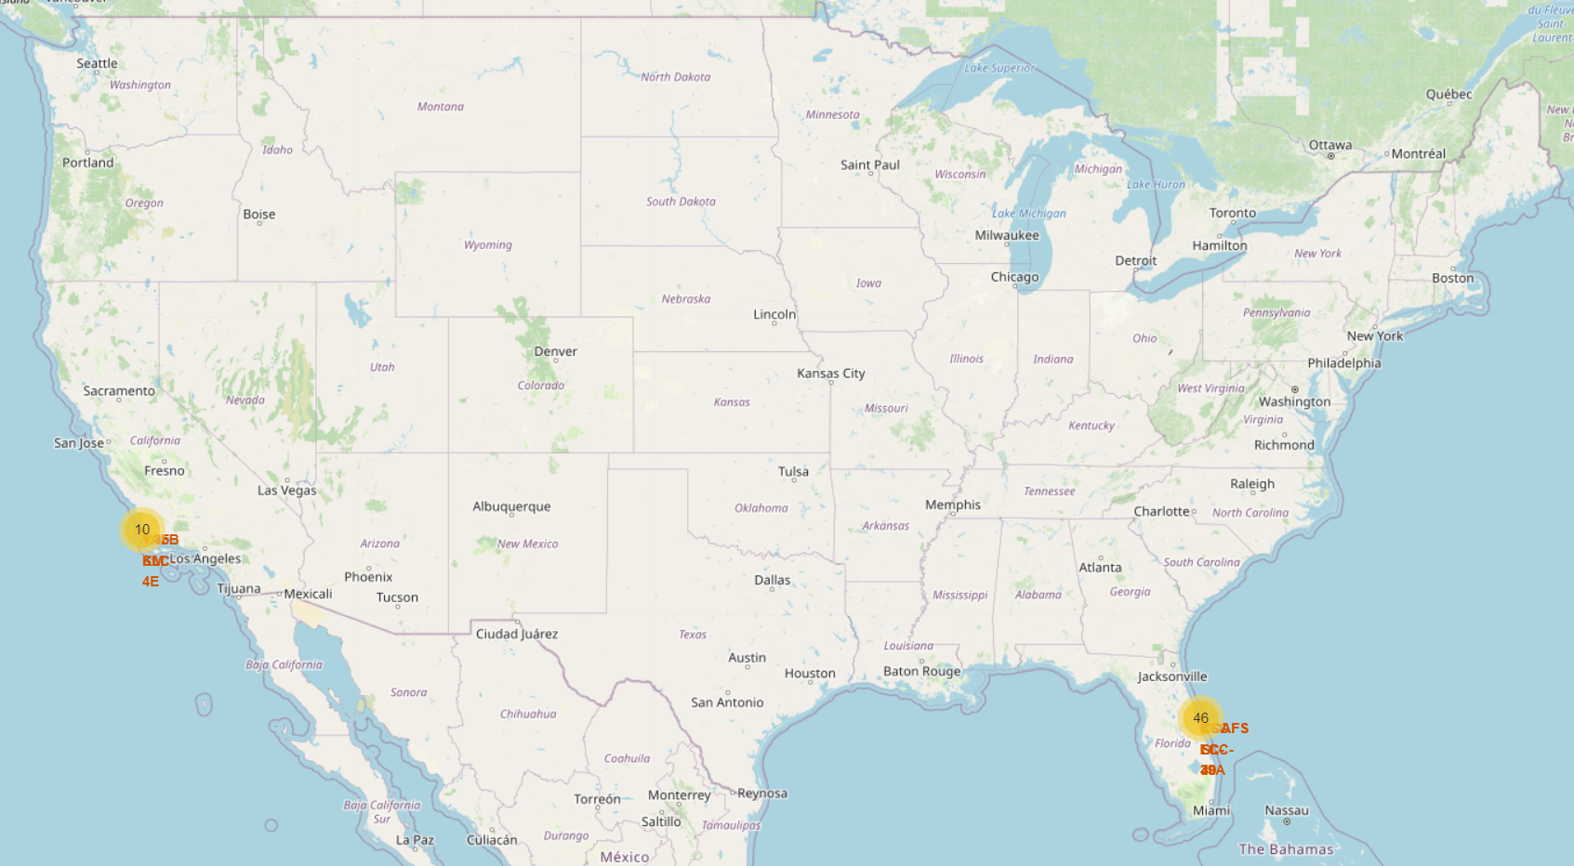
Map of All Space X Launches

Slide 36
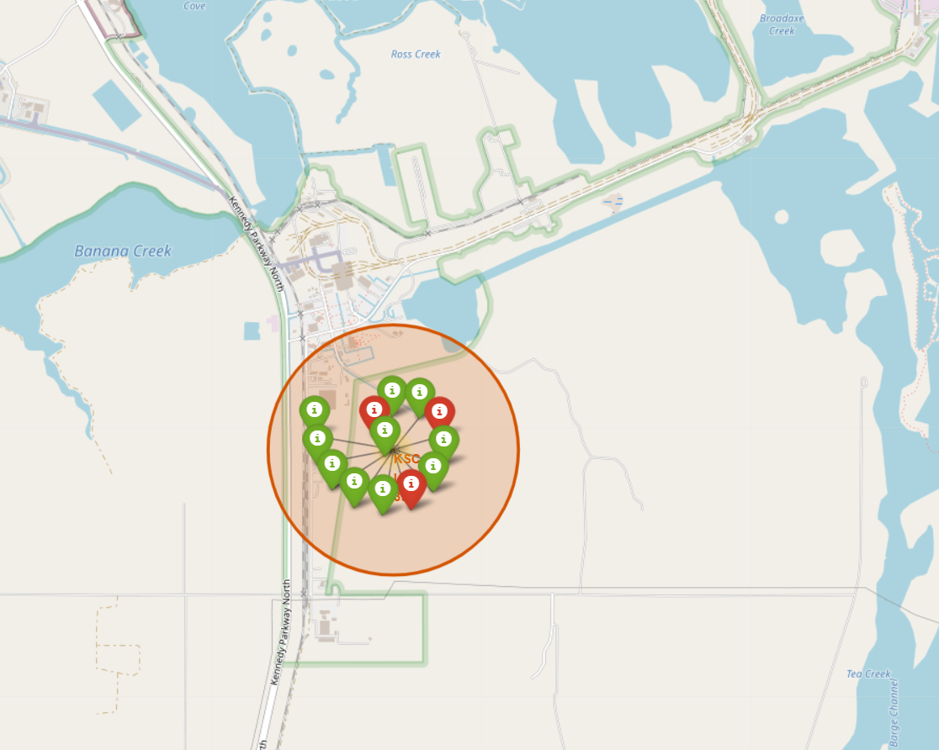
Attempted Launches at KSC

Slide 37
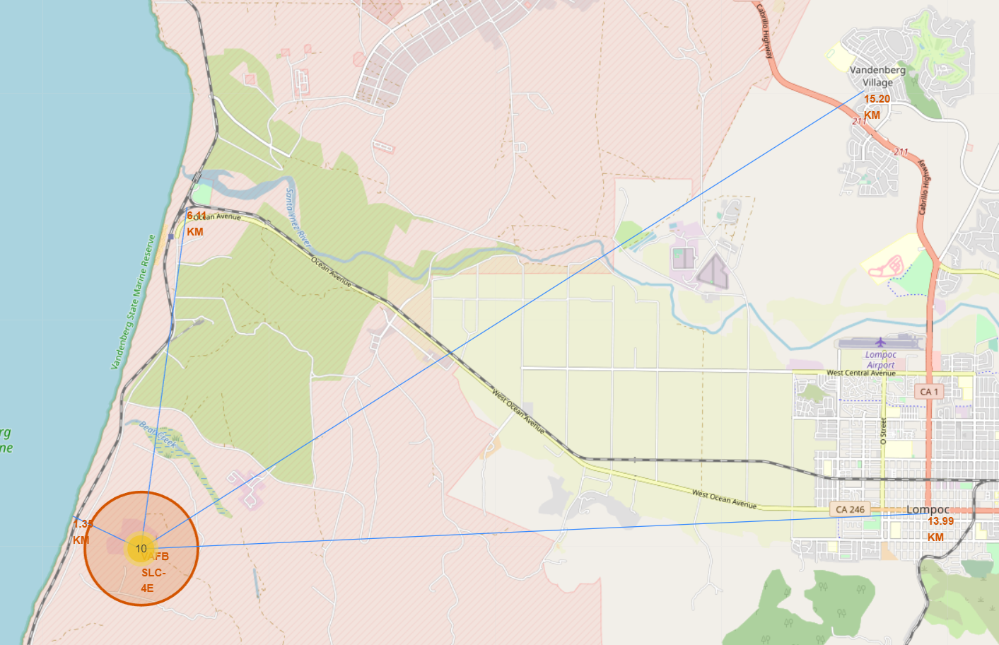
Key Points of Interest near VAFB

Slide 38

Section 4

Slide 39
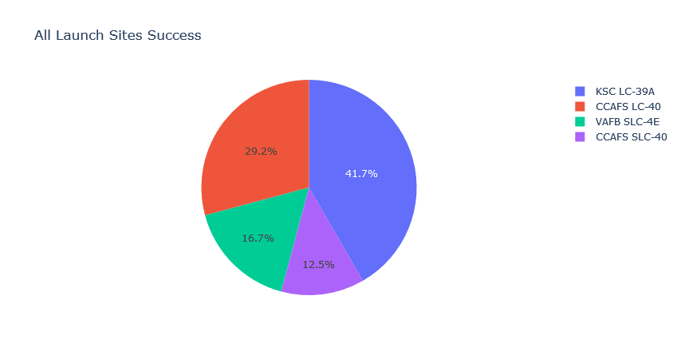
Success Rate Share per Site

Slide 40
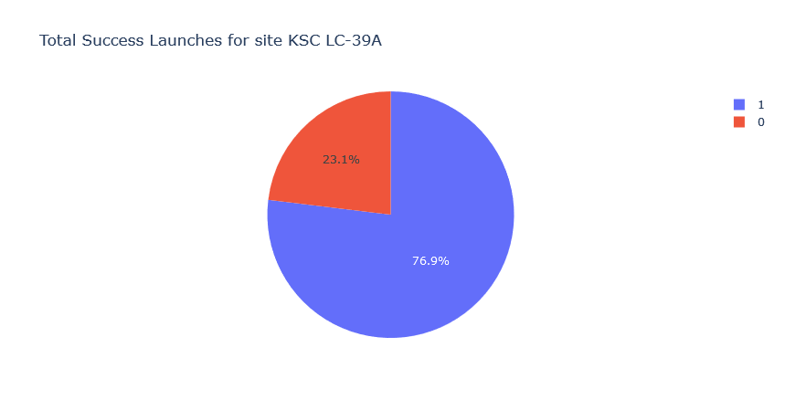
Highest Success Percentage

Slide 41
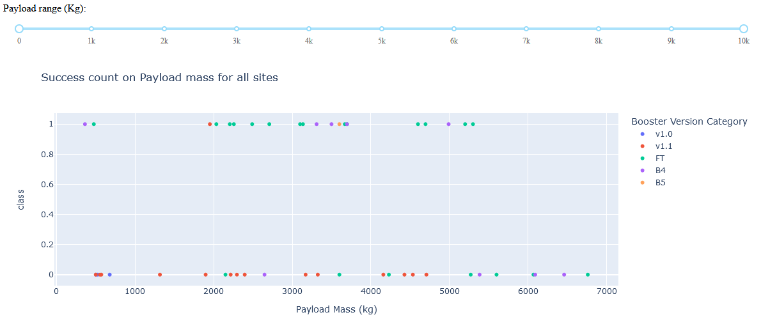
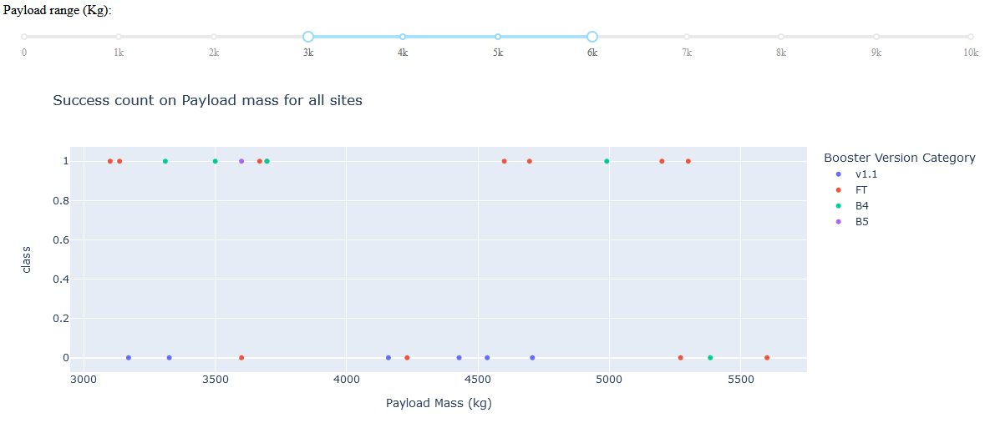
Successes in Payload Mass Range
All Sites

Slide 42

Section 5

Slide 43
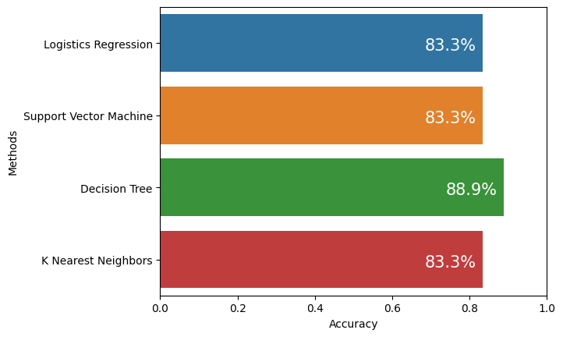
Classification Accuracy

Slide 44

Confusion Matrix

Slide 45
Conclusions
Tree Decision Machine Learning
Highest Success Rate at KSC
Success Rate increasing consistently over time
First Booster Successful Landing on 01-05-201
Learning

Slide 46


Slide 47
Back Up

Slide 48
Appendix

